Slide 1
Open Source for Navigation
Xun(Perry) Liu
4/10/2019

Slide 2

Story #1. How to organize mapdata for map streaming
What is map streaming
Off-line navigation
Return to Route
Regional Extracts
Cacheability
Updateability

Slide 3
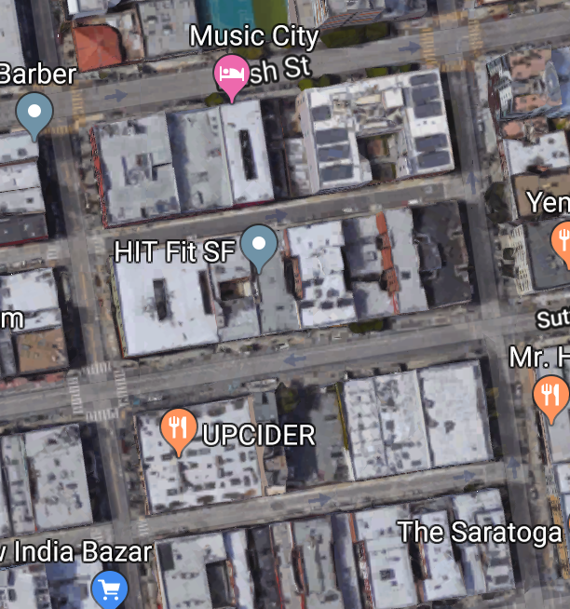
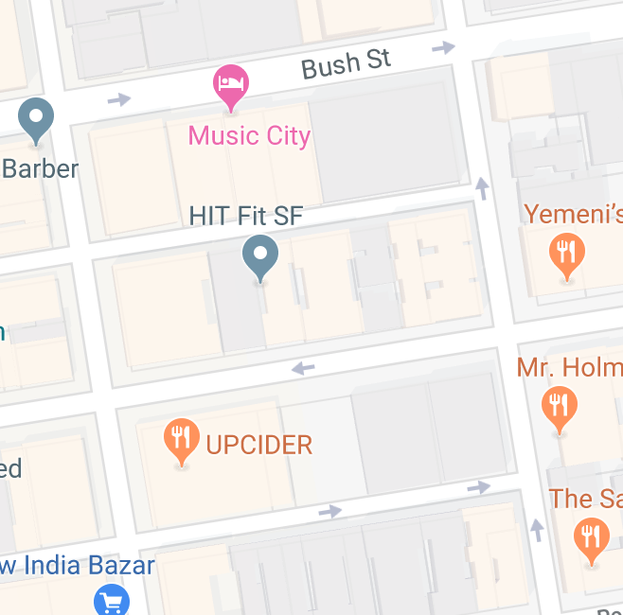
Terminology
Node
End
Edge
Shortest Path
Start
Graph
Tile
Notes:
The original picture tells the feature of destination adjustment from Lyft

Slide 4
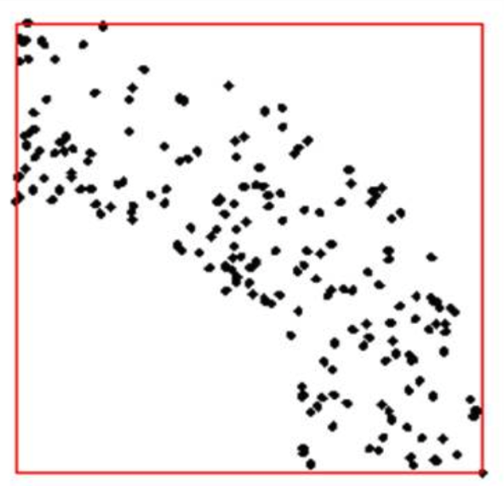
How to store data
Uber: How to find nearest ride?
Find k-th nearest element
Read only needed data
Balanced file size
Notes:
Add current data statistics

Slide 5
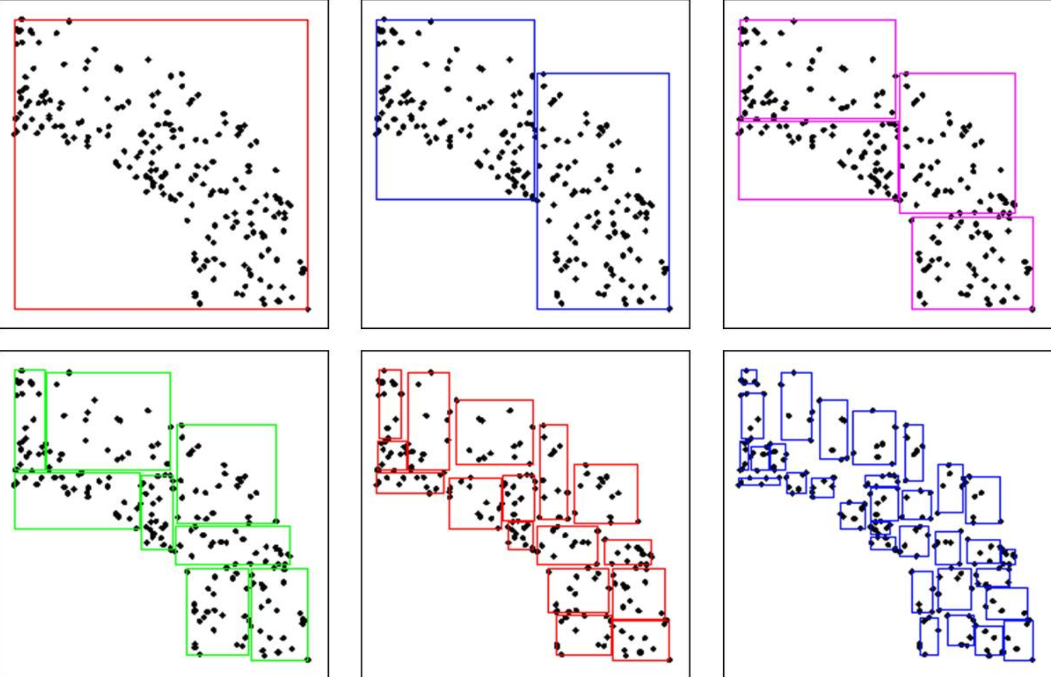
KD split
Threshold is 4096
Average count is 1000~2000
Average file size is 700KB
Need meta data for query
Easy to implement
Notes:
Add current data statistics

Slide 6
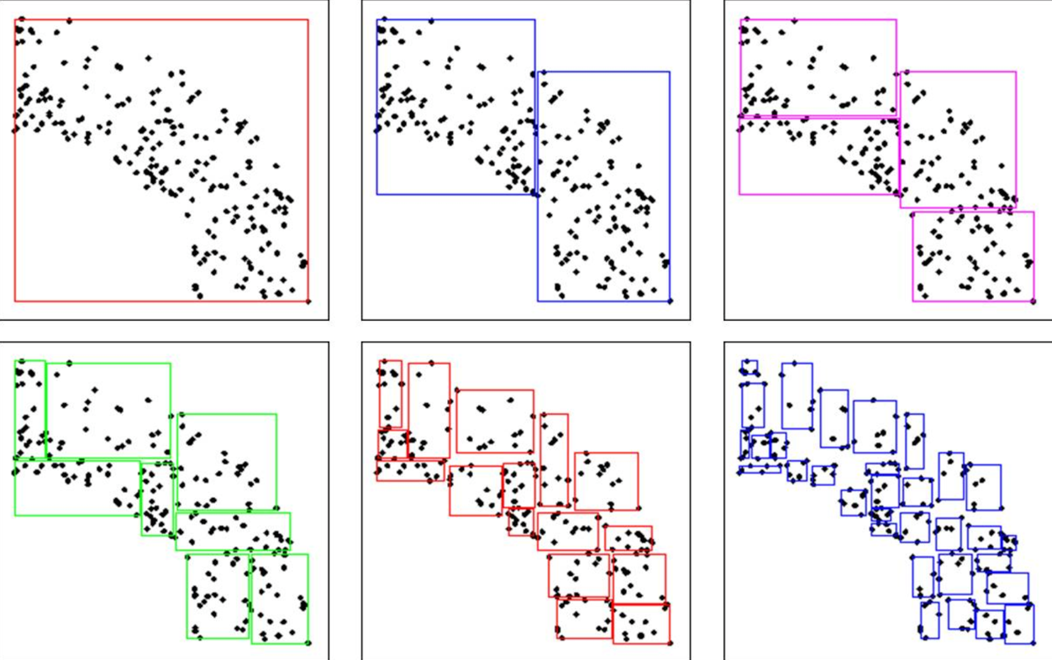
KD split
Element might move to different tile during quarterly update
Rely on data vender to keep data’s consistency
Notes:
Add current data statistics

Slide 7
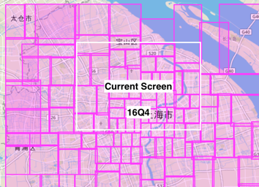
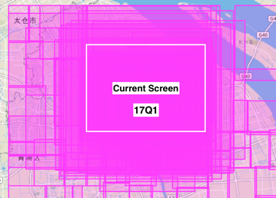
KD split
16Q4
17Q1
Notes:
Add current data statistics

Slide 8
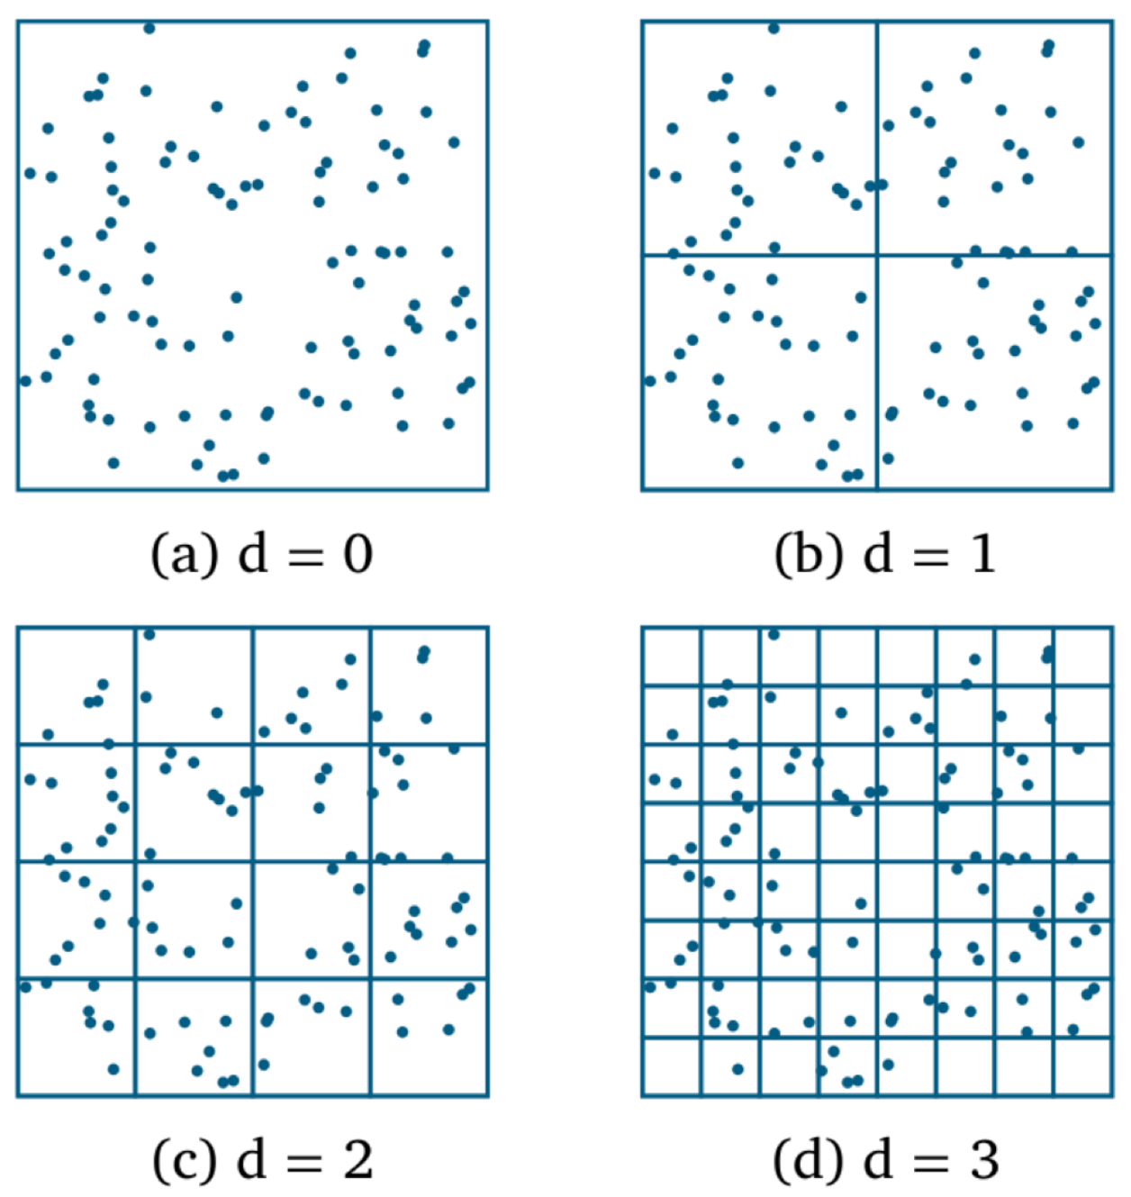
Keep data element stable
Fixed boundary split
Element will stay in fixed grid as long as no change for geometry
Grid id could be calculated by lat/lon
Cacheability/Updateability
File size depend on data density

Slide 9
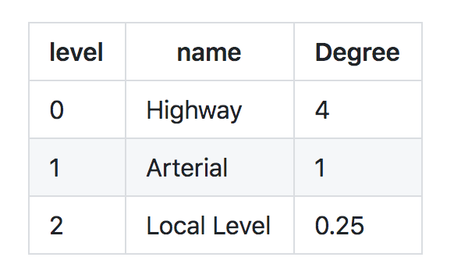
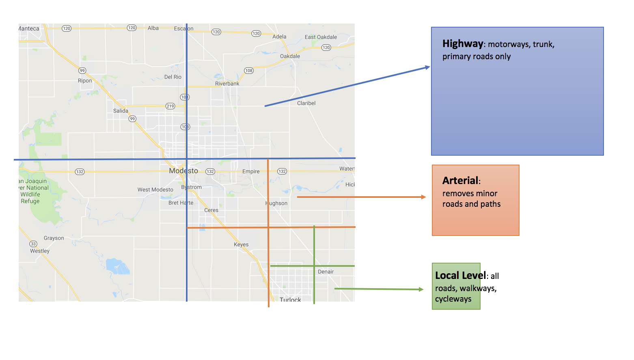
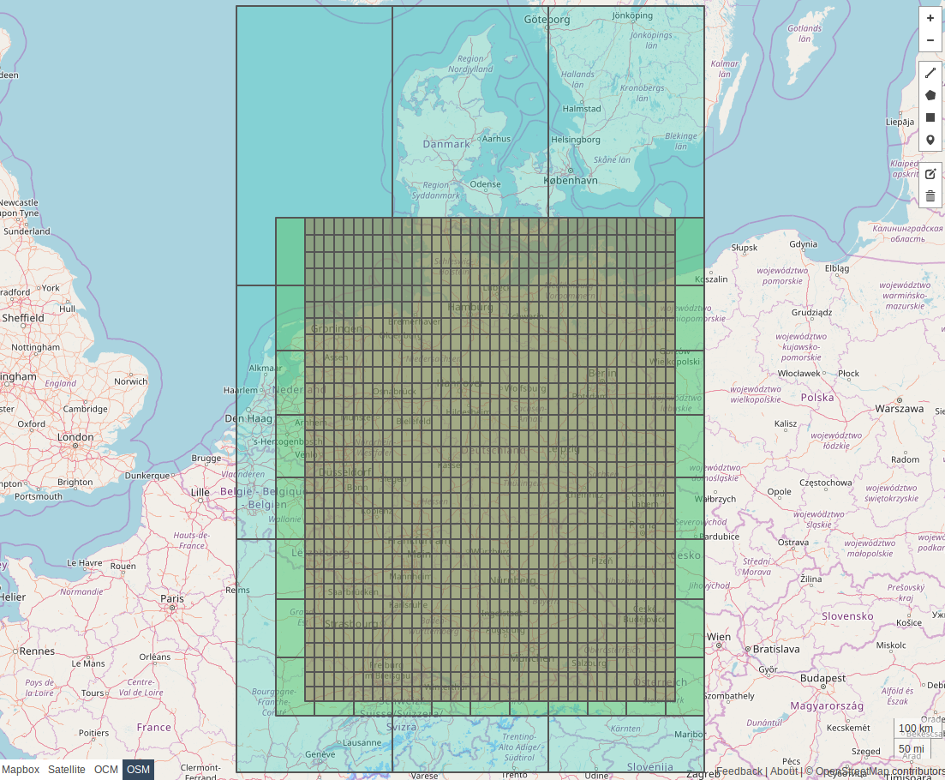
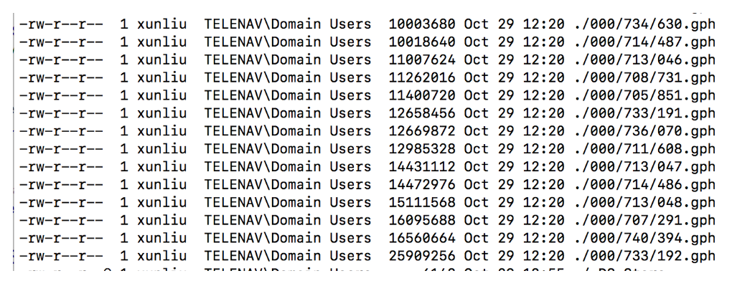
Valhalla Tiles
Fixed boundary tile
25MB

Slide 10
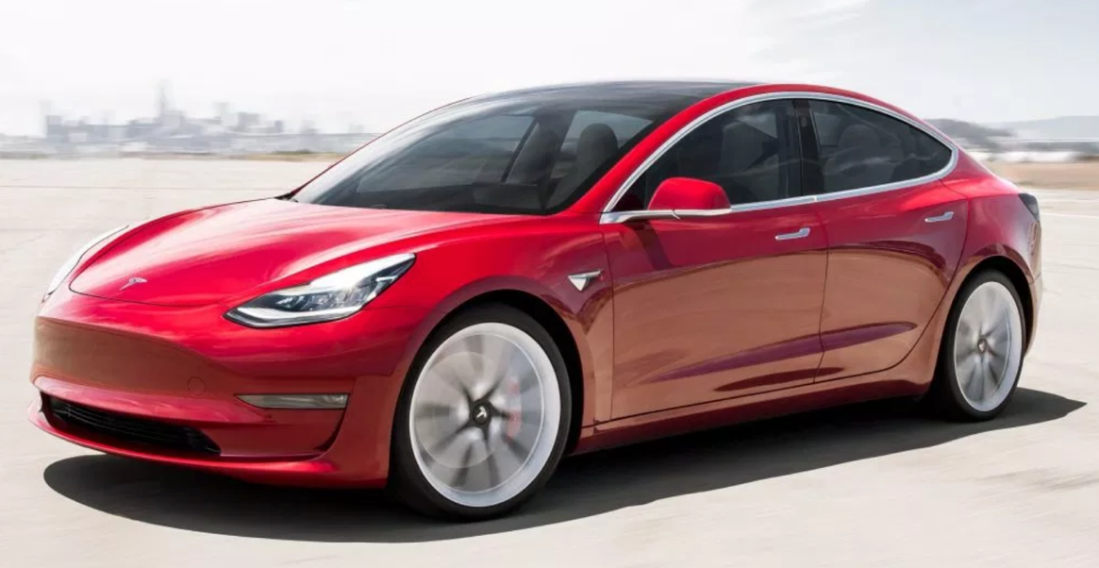
Lesson learned
Low level data organization affects feature tradeoff
Move data from dictionary to tiles
Fix boundary at space level, then at tile level
Re-build boundary’s connectivity based on geometry and road names/type etc

Slide 11

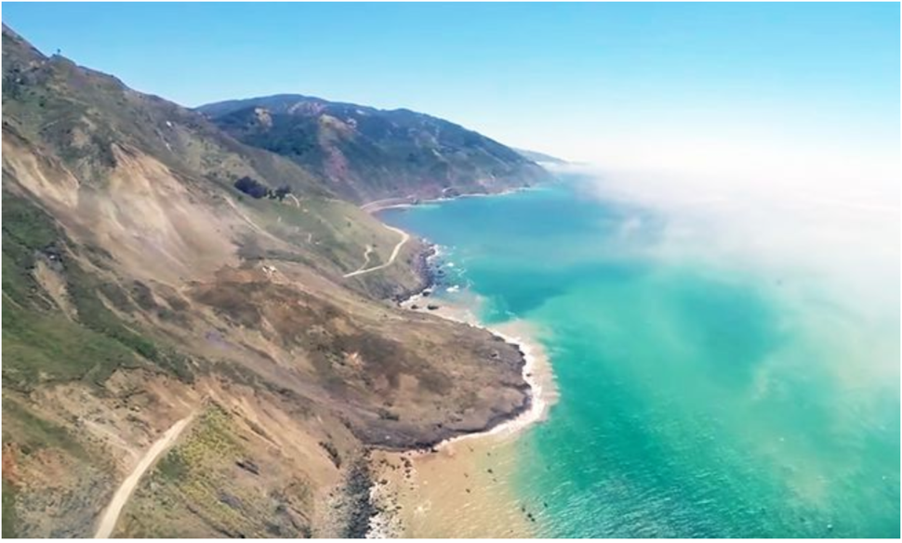
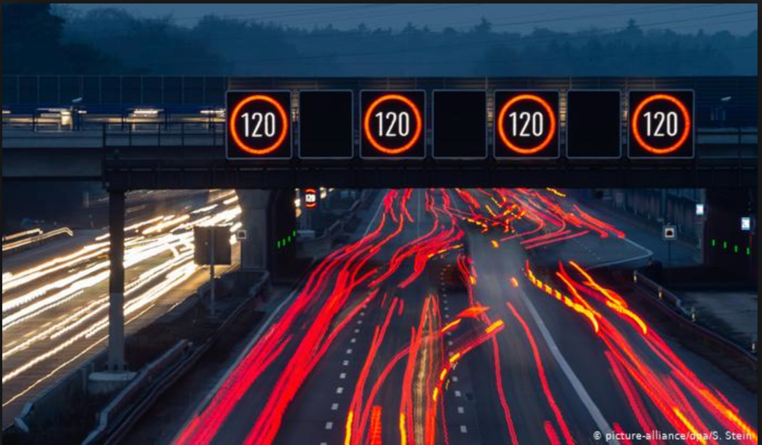
Story #2 Calculate route consider dynamic information

Slide 12
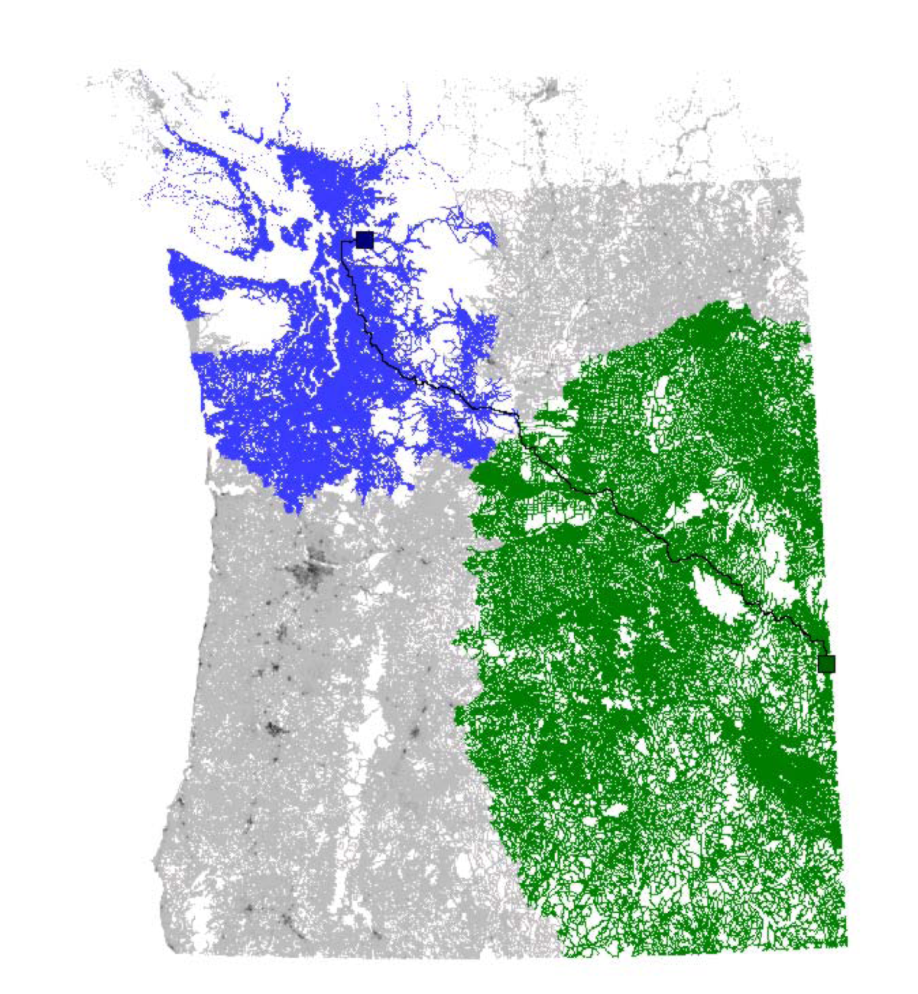
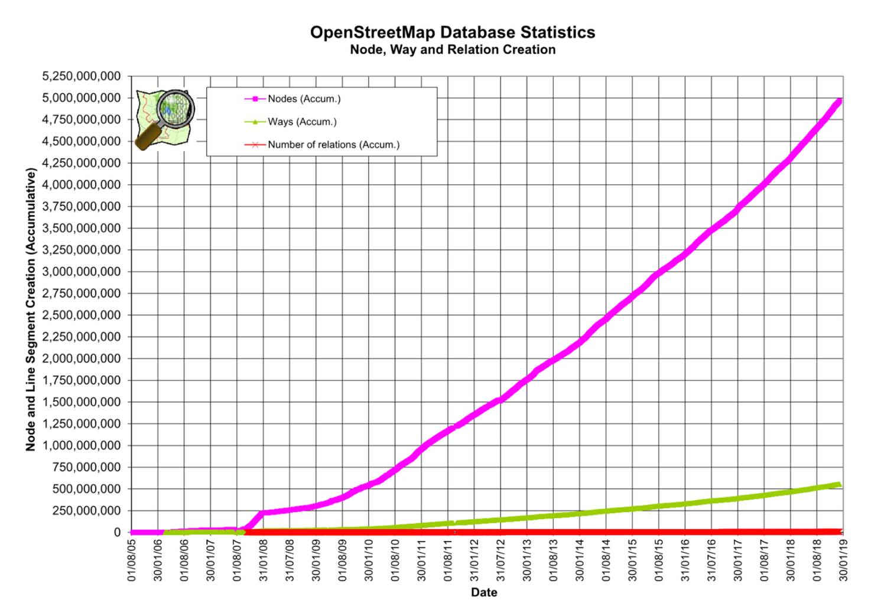
Story #2 Calculate route consider dynamic information
Chanllege of dynamic information
Notes:
The original picture tells the feature of destination adjustment from Lyft

Slide 13
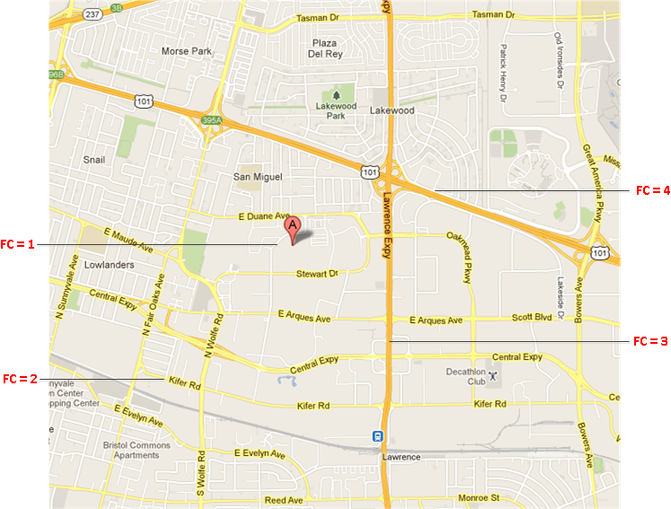
Function class Level promotion
FC value | Edge Count | Percent
1 | 38,342,700 | 81.63%
2 | 5,384,555 | 11.46%
3 | 1,810,361 | 3.85%
4 | 1,012,161 | 2.15%
5 | 417,404 | 0.889%
Total Edge Count | 46,967,181
Notes:
The original picture tells the feature of destination adjustment from Lyft

Slide 14
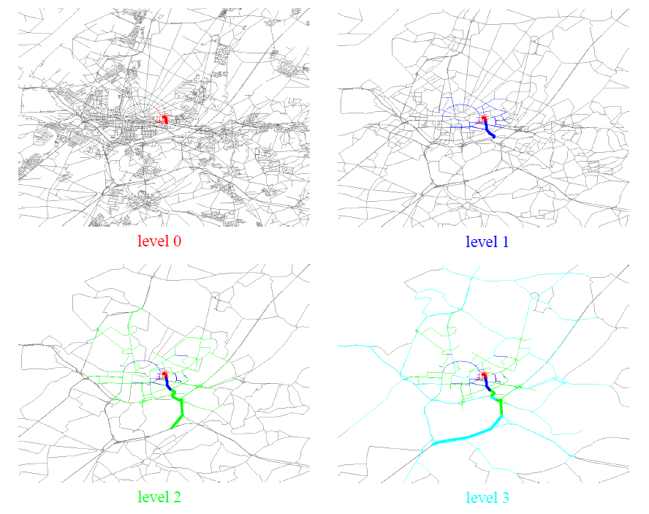
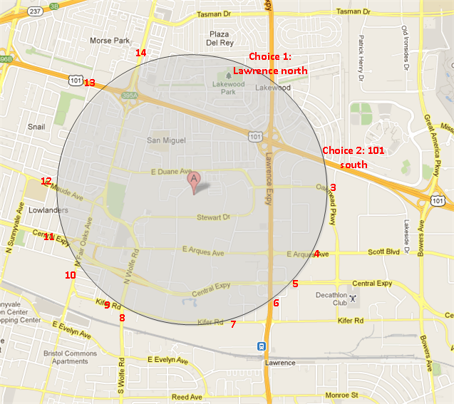
Function class Level promotion
Prune and Shrink
When to promote
Notes:
The original picture tells the feature of destination adjustment from Lyft

Slide 15
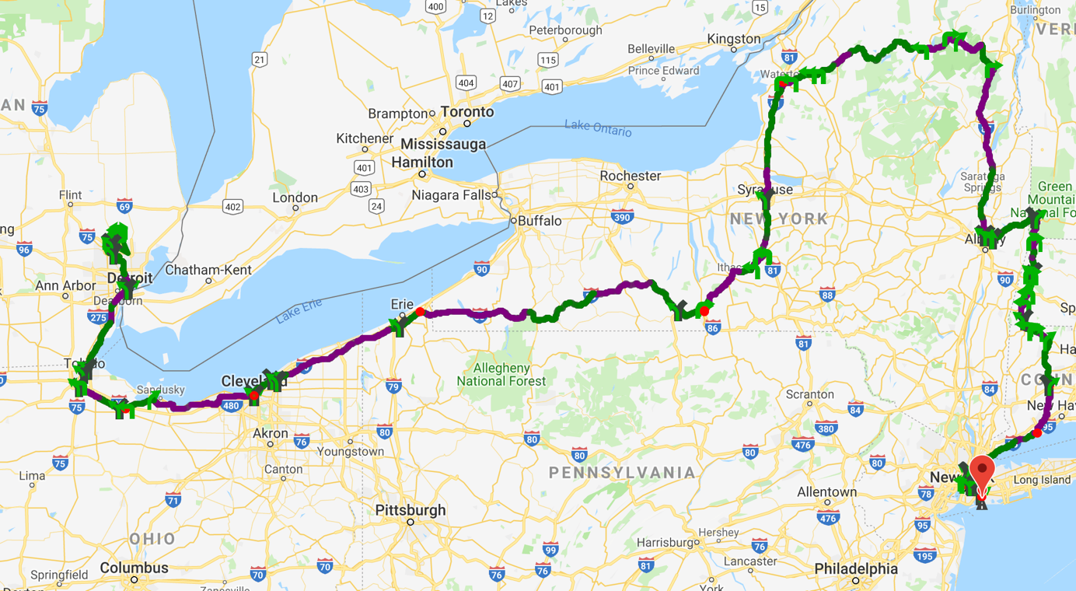
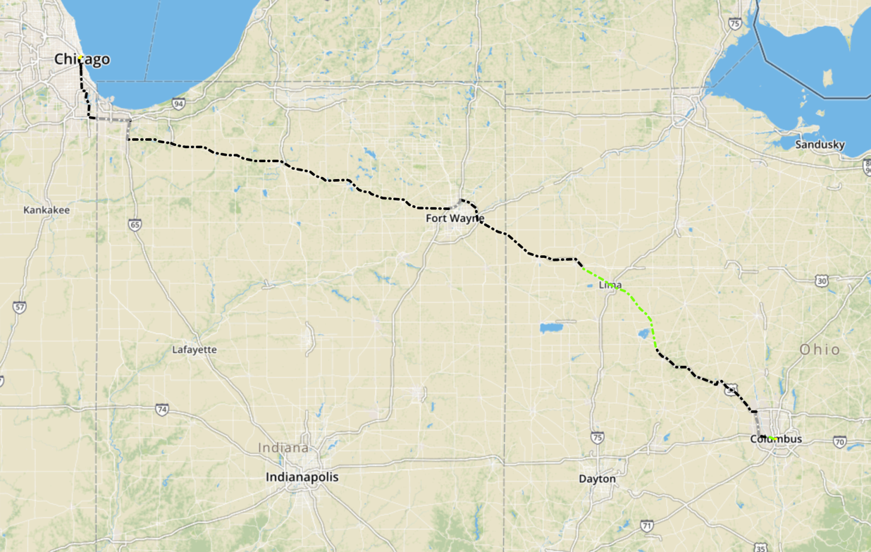
Function class Level promotion
Miss best candidate
Notes:
The original picture tells the feature of destination adjustment from Lyft

Slide 16
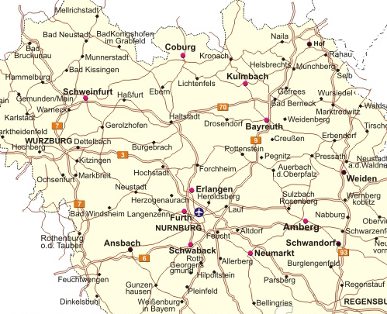
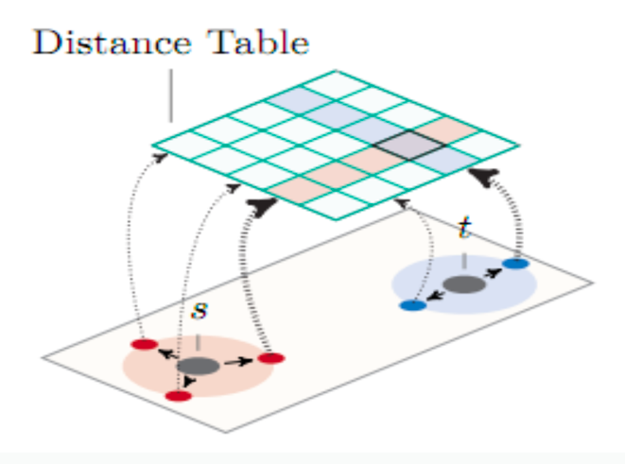
Partition the graph
By fixed size grid
Notes:
The original picture tells the feature of destination adjustment from Lyft

Slide 17
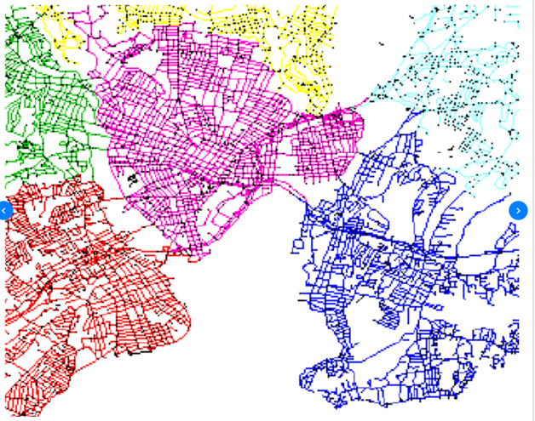
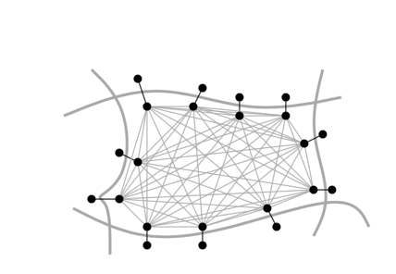
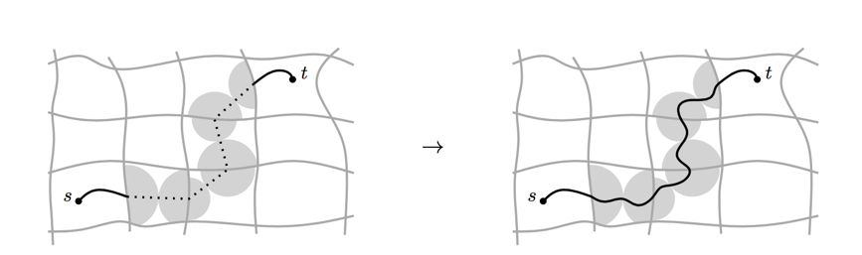
Customizable Route planning
Step 1: Metric independent preprocessing
Graph partition, preprocessing, hours
Step 2: Customization
Apply dynamic information with cost model
Each round of traffic update, seconds
Step 3: Query
Real time, per request, mili-seconds
Notes:
The original picture tells the feature of destination adjustment from Lyft

Slide 18
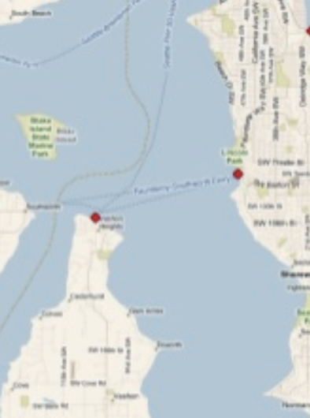
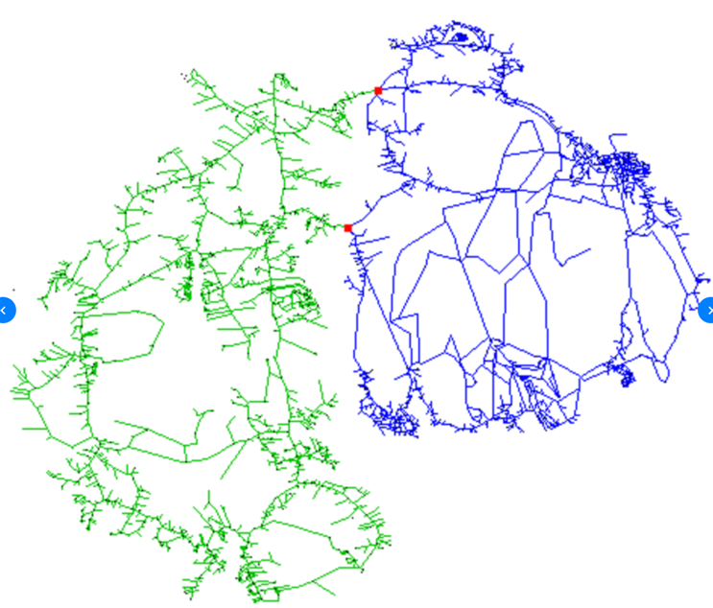
How to find min-cut
Notes:
The original picture tells the feature of destination adjustment from Lyft

Slide 19
How to find min-cut

Slide 20
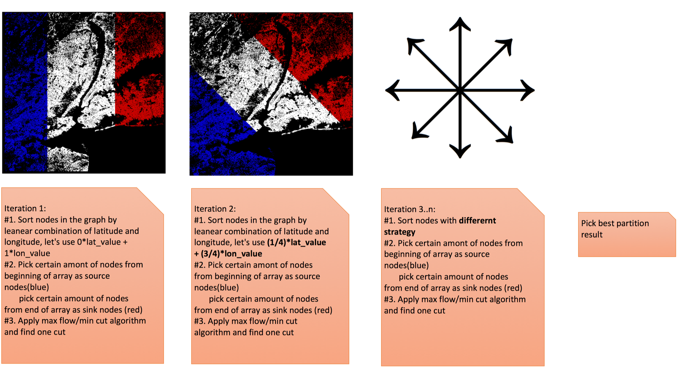
How to find min-cut

Slide 21
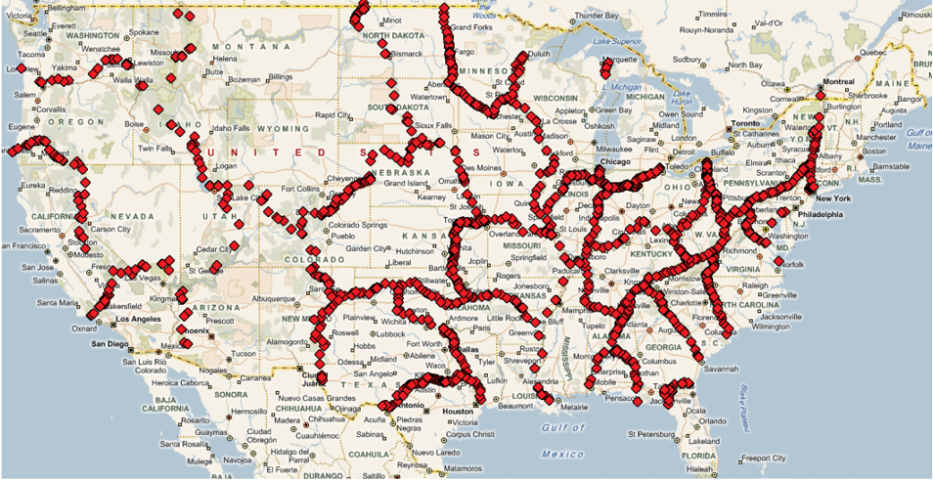
How to find min-cut

Slide 22
Lesson learned
Cloud side could use different strategy compare with embedded side
Divide and conquer

Slide 23
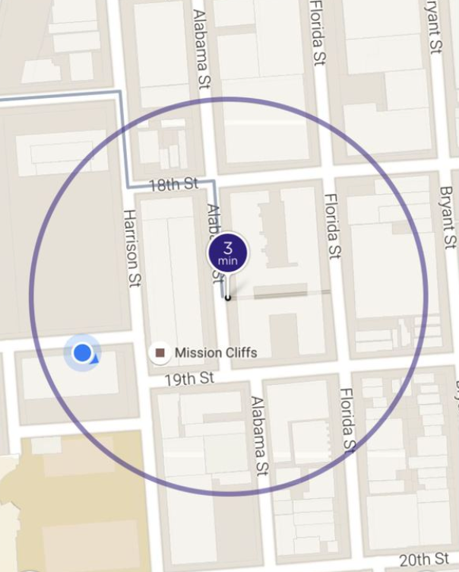
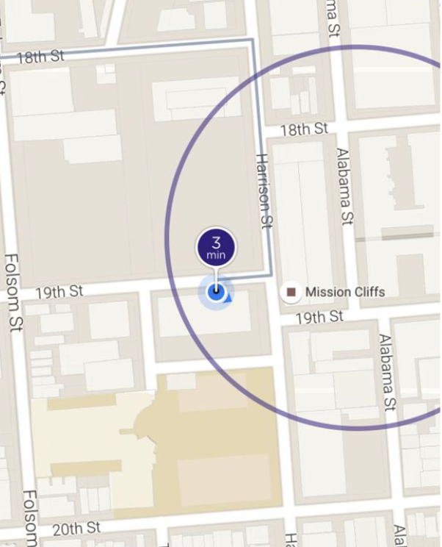
Story #3 Map Matching when the map data is wrong
A story about Lyft pick up
When Map data exists
No Map data
Notes:
The original picture tells the feature of destination adjustment from Lyft

Slide 24
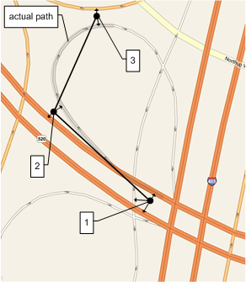
Offline Map Matching
What/How/Why
Give a sequence of GPS signals, find the most probable sequence of road segments

Slide 25
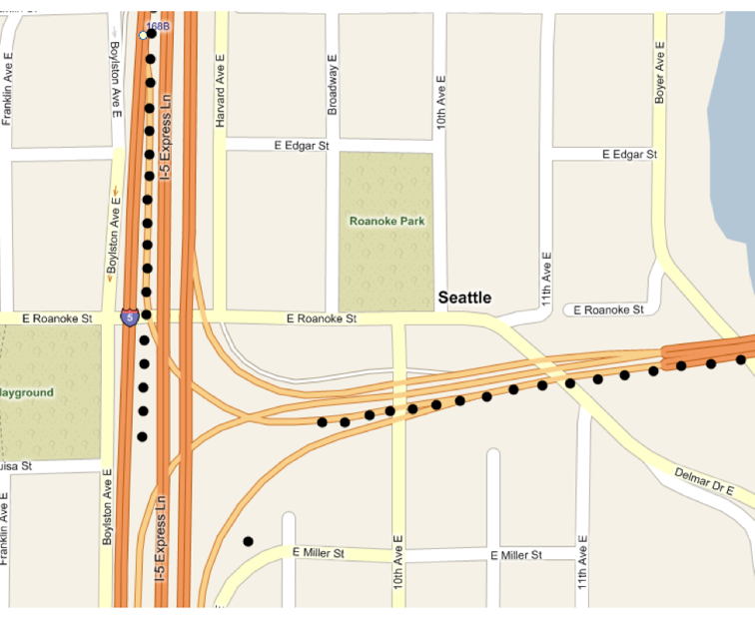
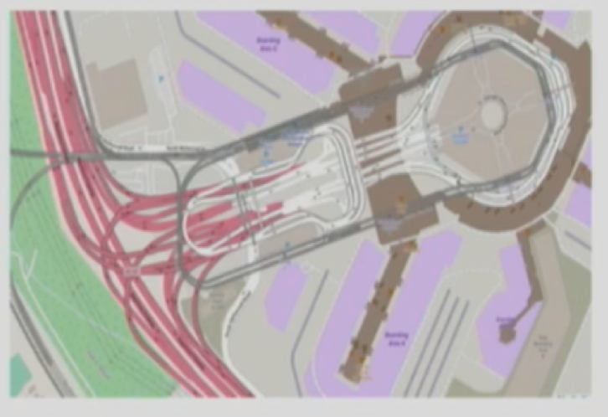
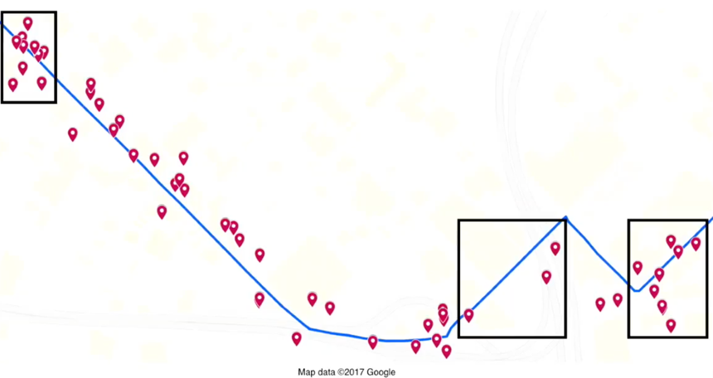
Offline Map Matching
What/How/Why/
Noise & Sparseness
Missing GPS
Wrong/Complex Map Data

Slide 26
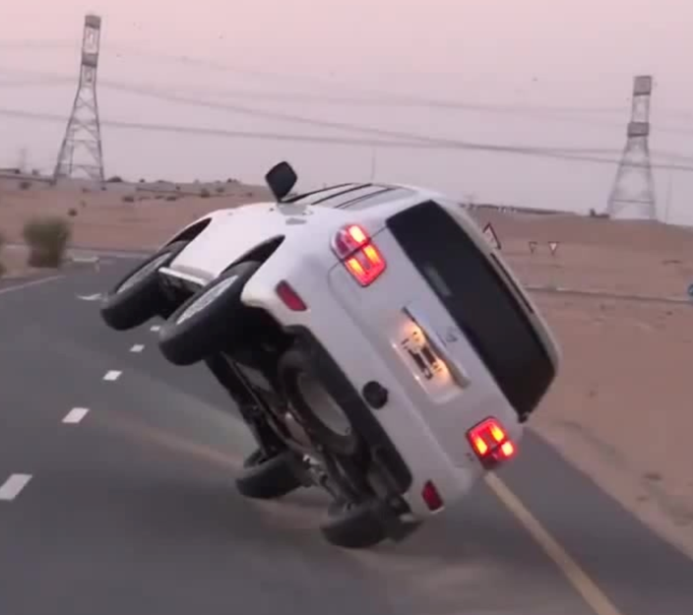
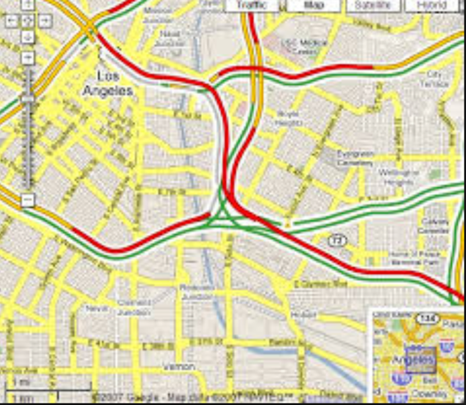
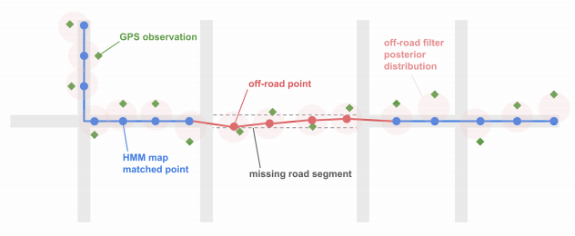
Offline Map Matching
What/How/Why
Historic/Live traffic/ETA
Enhance map data
User pattern
Notes:
Live traffic
Enhance map data
Analysis user pattern

Slide 27

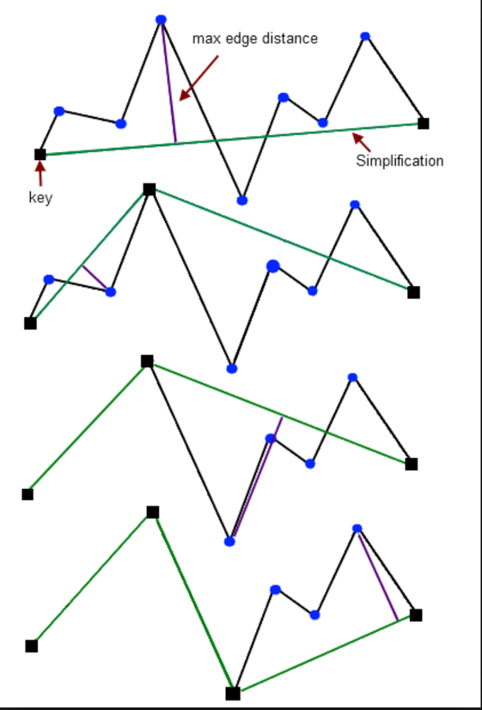
Map Matching logic
Lifecyle
Simplify points
Filter noise points
Find Nearest edges as Candidate
Consider trend
Optimal path

Slide 28
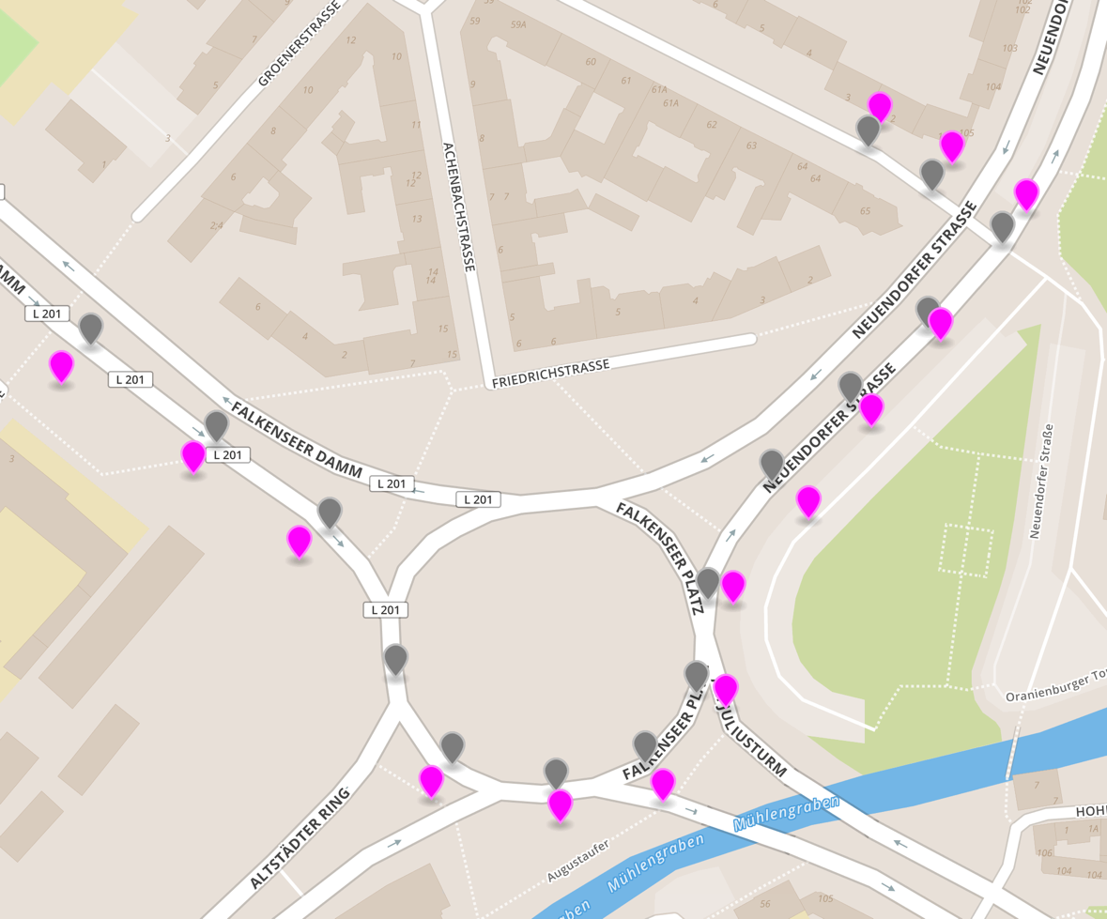
Map Matching logic
Lifecyle
Filter dense points
Filter noise points
Find Nearest edges as Candidate
Consider trend
Optimal path

Slide 29
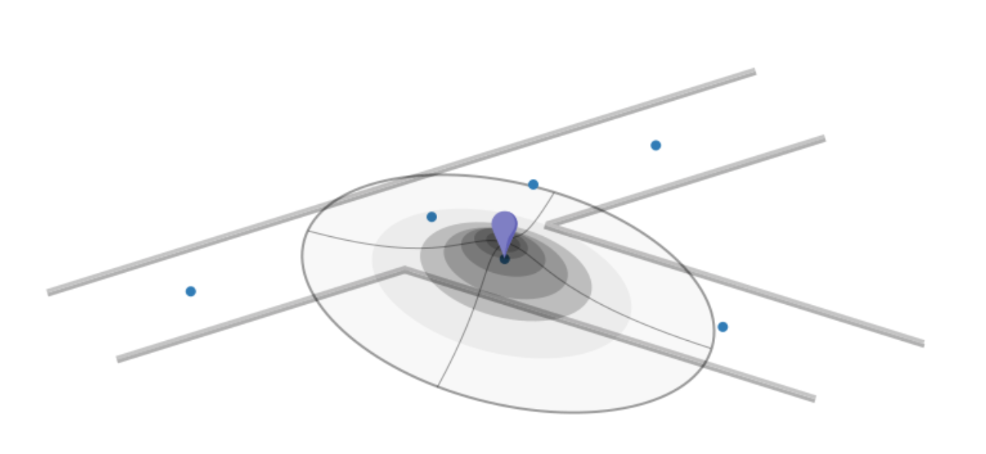
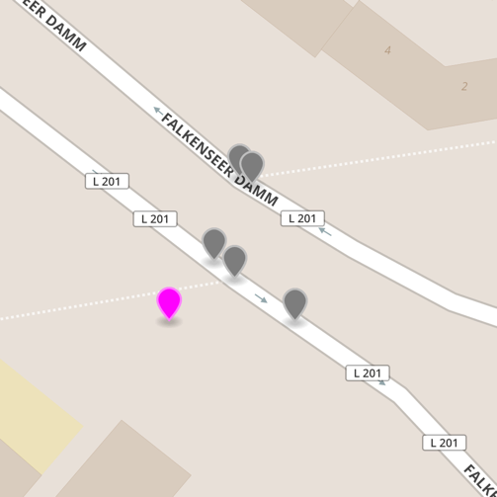
Map Matching logic
Lifecyle
Filter dense points
Filter noise points
Find Nearest edges as Candidate
Consider trend
Optimal path

Slide 30
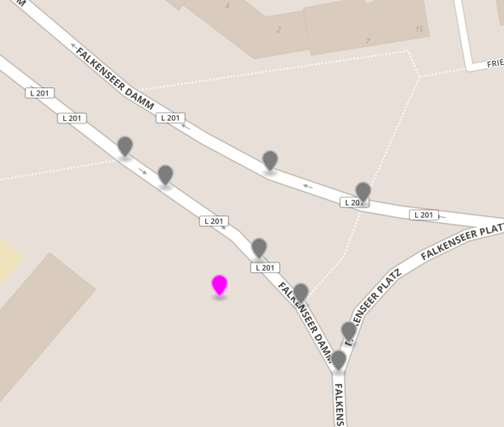
Map Matching logic
Lifecyle
Filter dense points
Filter noise points
Find Nearest edges as Candidate
Consider trend
Optimal path

Slide 31
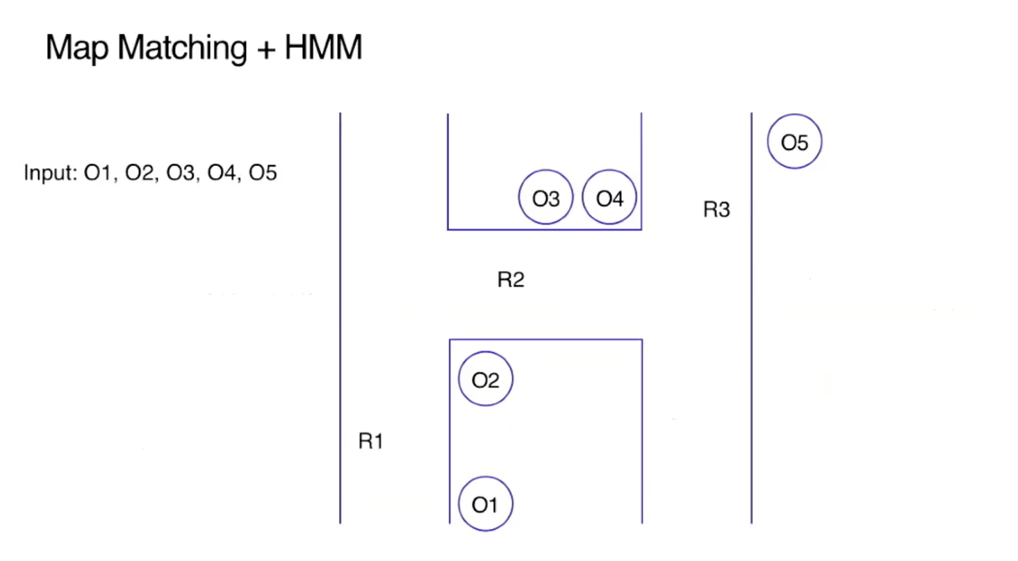
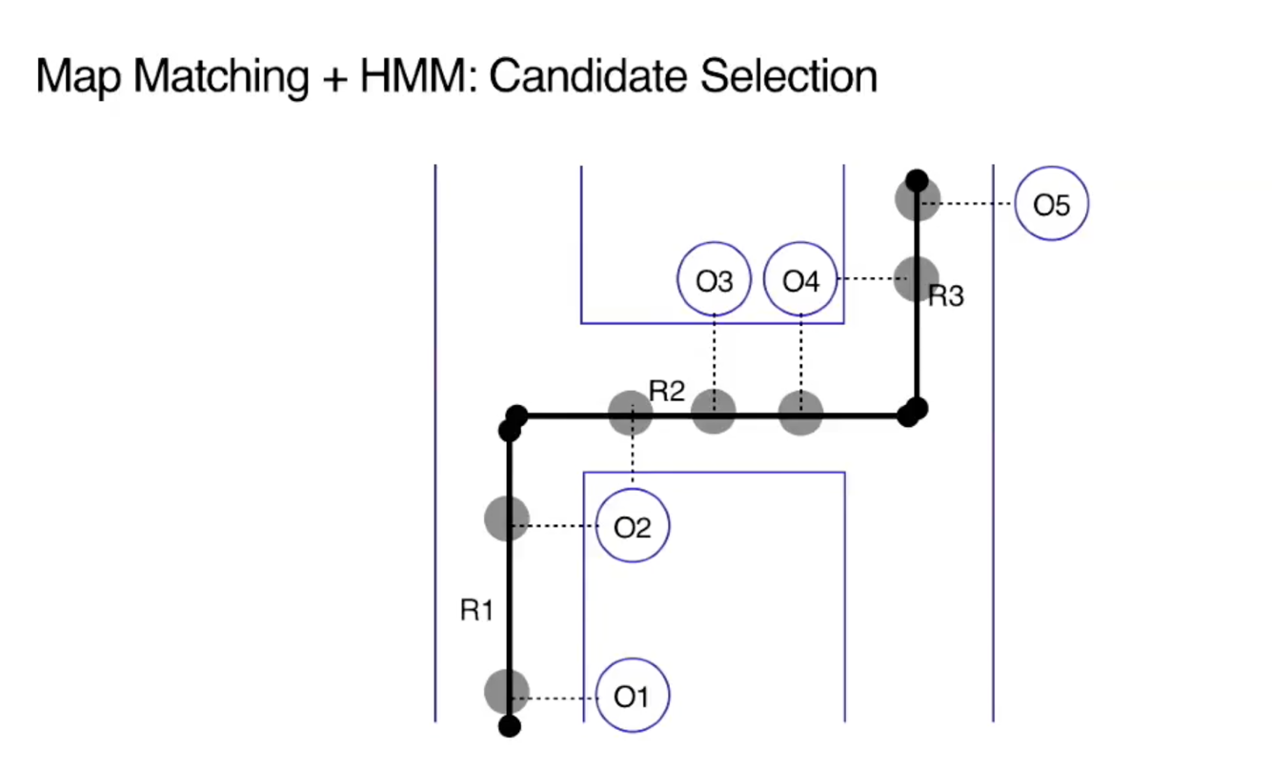
Map Matching logic
Lifecyle
Filter dense points
Filter noise points
Find Nearest edges as Candidate
Consider trend
Optimal path
Notes:
HMM -> Emission Cost -> Transition Cost
Dynamic programming

Slide 32
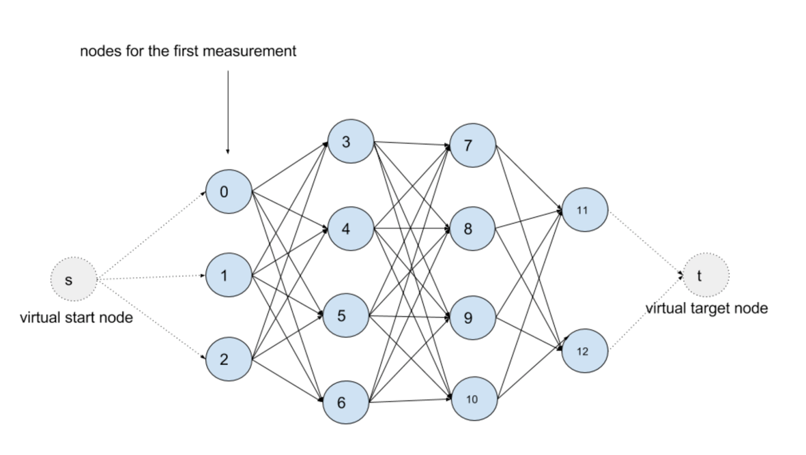
Map Matching logic
Lifecyle
Filter dense points
Filter noise points
Find Nearest edges as Candidate
Consider trend
Optimal path
Notes:
HMM -> Emission Cost -> Transition Cost
Dynamic programming

Slide 33

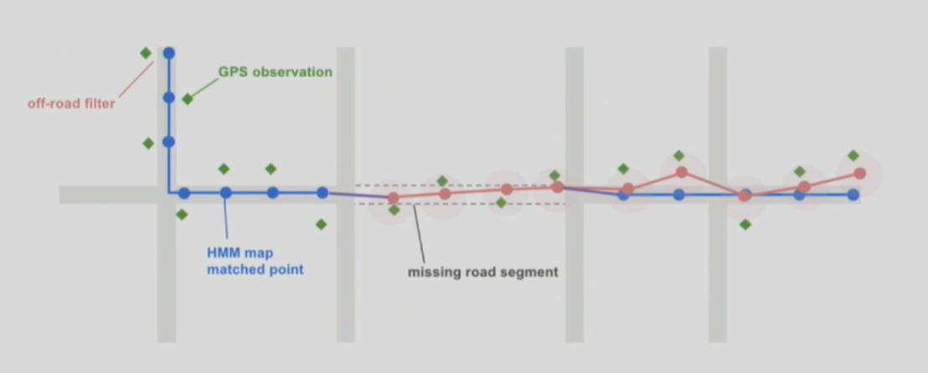

When map is wrong (LYFT’s way)

Slide 34


Lesson learned
Active open source community keeps your solution up to date
The unique and valid data makes your business win

Slide 35
When map is wrong (LYFT’s way)

